Slide 1
The messiness of learning: Uncovering fine-grained patterns of conceptual change in learners’ conceptions of force
Richard Brock
richard.brock@kcl.ac.uk

Slide 2
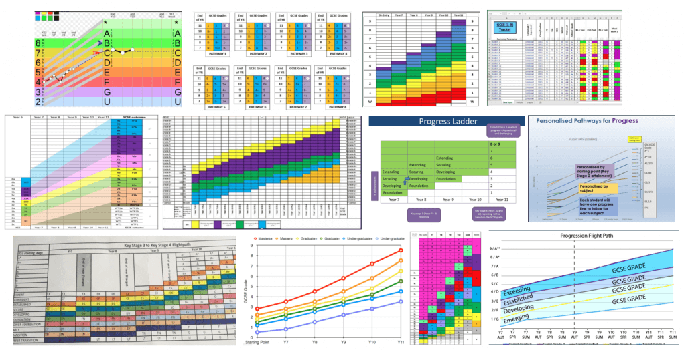
The notion of a flightpath

Slide 3
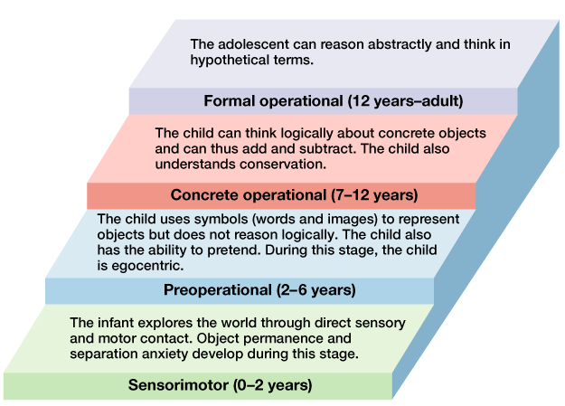
Piaget on development
• Piaget was employed to make French versions of English intelligence tests
• ‘Observation and experimentation combined seem to show that object concept, far from being innate or given readymade in experience, is constructed little by little. Six stages can be discerned, corresponding to those of intellectual development in general.’ (Piaget, 1954, p. 4)
Piaget, J. (1954). The Construction of Reality in the Child. Abingdon: Routledge, and Kegan Paul.

Slide 4
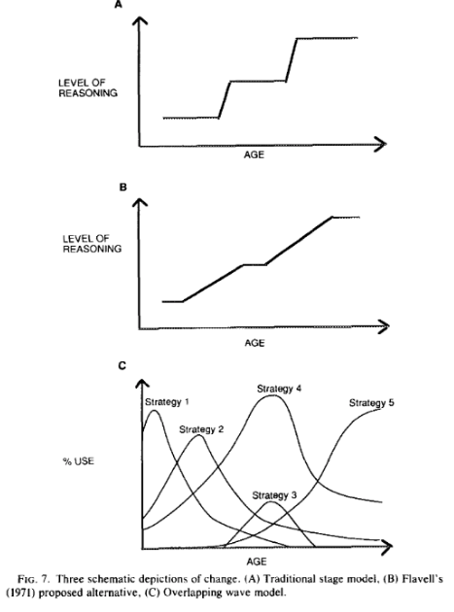
But…
• Development is not learning
• Abstraction understanding of causality can occur at an early age (Wellman & Liu, 2007)
• ‘the complexity of the developmental sequence may not be limited to brief-lived transitional periods. Rather than varied ways of thinking only being present brieﬂy, children of a given age have been found to think in multiple ways about the same concept and to use multiple strategies to solve a given kind of problem over a period of years. Such prolonged use of multiple strategies has been found in domains as diverse as arithmetic, word identiﬁcation, spelling. time telling, serial recall, and physics problem solving, and for people of all ages from 4 years to adulthood (Siegler, 1995, p. 230)
Figure 7 in Siegler 1995, p. 266
Siegler, R. S. (1995). How does change occur: A microgenetic study of number conservation. Cognitive psychology, 28(3), 225-273.
Wellman, H. M., & Liu, D. (2007). Causal reasoning as informed by the early development of explanations. In A. Gopnik & L. Schulz (Eds.), Causal learning: Psychology, philosophy, and computation (pp. 261–279). Oxford: Oxford University Press.

Slide 5
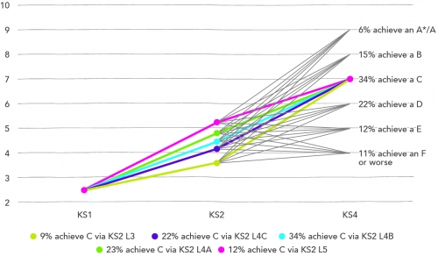
FFT Education Datalab analysis
‘More children get to the ‘right’ place in the ‘wrong’ way, than get to the ‘right’ place in the ‘right’ way!’
‘Moreover, the capacity of the model to accurately predict pupil’s attainment falls in secondary schools, with 45% of pupils making the anticipated linear progress between Key Stage Two and Key Stage Three, and just 33% making the anticipated linear progress between Key Stage Three and Key Stage Four. ‘
• ‘Children with low initial attainment have particularly unpredictable future attainment’
Treadaway, M. (2015). Why measuring pupil progress involves more than taking a straight line. FFT Datalab Blog, Available at: https://ffteducationdatalab.org.uk/2015/03/why-measuring-pupil-progress-involves-more-than-taking-a-straight-line/
[Accessed 21st June 2021]

Slide 6
The origins of the microgenetic approach
‘The content of experience at any time cannot be given through the exhibition of a manifold of elements… Only a further and further dissection, and a destructive analysis, can ever arrive at those disconnected pieces which the old psychology designated as elements.’ (Sander, 1930, p. 192)
Sander, F. (1930). Structures, totality of experience, and gestalt. In C. Murchinson (Ed.) Psychologies of 1930 (pp. 188-204). Worcester, MA: Clark University Press.
For a historical summary of the development of microgenetic research see: Catán, L. (1986). The dynamic display of process: Historical development and contemporary uses of the microgenetic method. Human Development, 29(5), 252–263

Slide 7
The origins of the microgenetic approach
‘…any human activity such as perceiving, thinking, acting, etc., is an unfolding process, and this unfolding or "microgenesis," whether it takes seconds or hours or days, occurs in developmental sequence’ (Werner, 1956, p. 347).
‘To encompass in research the process of a given things development in all its phases and changes—from birth to death—fundamentally means to discover its nature, its essence, for “it is only in movement that a body shows what it is.”’ (Vygotsky 1930/1978, p. 65)
Vygotsky, L. S. (1930/1978). Mind in society: The development of higher psychological processes. Cambridge, MA: Harvard University Press.
Werner, H. (1956). Microgenesis and aphasia. Journal of Abnormal Social Psychology, 52(3), 347-353

Slide 8
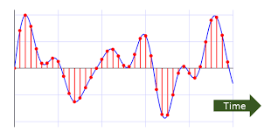
The microgenetic approach
(a) Observations span the entire period from the beginning of the change to the time at which it reaches a relatively stable state.
(b) The density of observations is high relative to the rate of change of the phenomenon.
(c) Observed behaviour is subjected to intensive trial-by-trial analysis, with the goal of inferring the processes that give rise to both quantitative and qualitative aspects of change. (Siegler & Crowley, 1991, p. 606)
Siegler, R. S, & Crowley, K. (1991). The microgenetic method: a direct means for studying cognitive development. American Psychologist 46(6), 606–620.

Slide 9
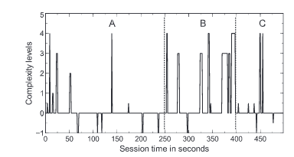
Example microgentic study: Van der Steen and colleagues (2014)
• C.f. Shannon (1949)
• One 4-year-old boy.
• Task involving syringes of equal volume connected by a tube.
• Boy encouraged to explore and prompted with questions.
• 10-minute video recorded session (with a 3 month + 6 month follow up).
• Utterances time stamped and graded for complexity based on skill theory by 3 raters into 5 levels
• Taking the initiative in interactions linked with learning
Figure 1 (Van der Steen et al., 2014, p. 87) Time-serial illustration of the complexity levels measured in the boy's answers Note. Utterances classified as incorrect are depicted as−1, and right answers to close-ended questions are marked as 0.5.
Shannon,C. E. (1949). Communication in the presence of noise. Proceedings of the Institute of Radio Engineers, 37(1), 10–21
Van Der Steen, S., Steenbeek, H., Van Dijk, M., & Van Geert, P. (2014). A process approach to children's understanding of scientific concepts: A longitudinal case study. Learning and Individual Differences, 30, 84-91.

Slide 10
An illustrative example
Session | Focus
1 | Force concept questions
2 | Pendulum, forces on a car question
3 | Mass on a spring, forces on an astronaut.
4 | Loop-the-loop, forces on a swung ball.
5 | Concept map, ball in a bowl apparatus.
11 | Concept map ball thrown vertically, situation card sort
12 | Problem card sort, bag in a braking car
13 | Questions about concepts’ properties, Leaping from crouch question
14 | Weightlessness questions, force concept ontology table
15 | Concept map, force concept questions, ball in bowl, pendulum, and mass on a spring
16 | Forces on astronaut, ball in bowl
22 | Concept map, force concept questions, pendulum, Ball in a bowl, mass on spring, forces on an astronaut, force concept ontology table
• RQ: ‘What temporal patterns of conceptual change can be constructed in the cases of four 16-17-year-old students learning about forces?’
• Sample: four 16-17-year-old students (Ben, Charlie, Daniel & Edward), taking an elective physics course at a school in England.
• Purposeful sampling
• Interviewed for approximately 25 minutes, once a week, for 22 non-consecutive weeks, covering a period of approximately six months.
• Semi-structured interviews using interviews-about-events (White & Gunstone, 1989) - students presented with a piece of apparatus and asked to develop an explanation of what they observed
Brock, R., & Taber, K. S. (2020). Making claims about learning: a microgenetic multiple case study of temporal patterns of conceptual change in learners’ activation of force conceptions. International Journal of Science Education, 42(8), 1388-1407.

Slide 11
Data analysis
• The Aristotelian/Impetus model of force (Viennot, 1979) and the Newtonian conception
Viennot, L. (1979). Spontaneous reasoning in elementary dynamics. European Journal of Science Education, 1(2), 205–22 Brock, R., & Taber, K. S. (2020). Making claims about learning: a microgenetic multiple case study of temporal patterns of conceptual change in learners’ activation of force conceptions. International Journal of Science Education, 42(8), 1388-1407.

Slide 12
How long is ‘the entire period’ of change?
Force linked to acceleration
Force linked to motion
Figure 1. Representations across all contexts. The markers indicate the position of an utterance within a session. Note, therefore, that the x- axes are discontinuous in these representations.
Force linked to acceleration
Force linked to motion

Slide 13
What is a ‘relatively stable state’?
Force linked to acceleration
Force linked to motion

Slide 14
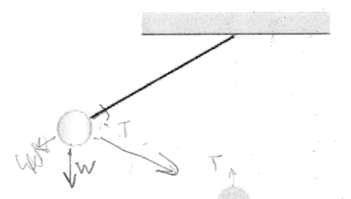
What is a ‘density of observations [that] is high relative to the rate of change of the phenomenon’?
• C.f. Shannon (1949)
• Conceptual change typically takes weeks or months to reach a stable state (Shuell, 1990).
Ben was considering the motion of a pendulum and initially argued the resultant force was zero when the pendulum was at maximum displacement.
‘Because I want to get for it to [be] stationary. I want tension to completely cancel out the weight [pause] and yet my arrows don’t. Ah! I think I might know. Here I think what’s happening is there is a force acting on it, but it’s acting completely opposite to the direction of motion.’ (Ben, Session 22, 591)
Shannon, C. E. (1949). Communication in the presence of noise. Proceedings of the Institute of Radio Engineers, 37(1), 10–21
Shuell, T. J. (1990). Phases of meaningful learning. Review of Educational Research, 60(4), 531–547.

Slide 15
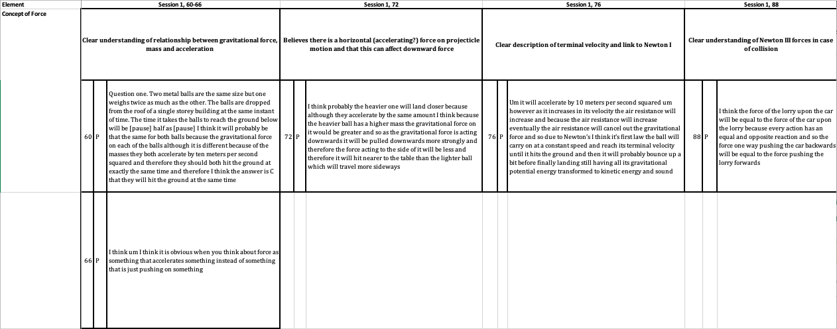
What is a ‘intensive trial-by-trial analysis’?

Slide 16
Representing change
Force linked to acceleration
Force linked to acceleration
Force linked to motion
Force linked to motion
Force linked to acceleration
Force linked to motion

Slide 17
The microgenetic approach
‘A critical feature of the method is that it allows change to be viewed as ‘untidy’, rather than the ‘tidy’ transition suggested by cross-sectional or longitudinal studies’ (Flynn, Pine & Lewis, 2007, p. 4)
Force linked to acceleration
Force linked to motion
Flynn, E., Pine, K., & Lewis, C. (2007). Using the microgenetic method to investigate cognitive development: an introduction. Infant and Child Development: An International Journal of Research and Practice, 16(1), 1-6.

Slide 18
The signal and the noise
‘… many elicited ideas will be transient and have little long-term consequence for conceptual development, and it is important to discriminate significant progression in thinking from mental flotsam and jetsam’ (Taber, 1995, p. 95)
‘also they [forces] tend to cause some of order or regularity... Like the um electromagnetic force it causes electrons to be roughly uniformly spread out… Or with gravity it causes everything to sink into a single point’ (Ben, session 14)
‘I think it’s things having to become disordered…that’s also why because because acceleration is a manifestation of disorder force… Because disorder requires things to change and force it’s a potential for change but force doesn’t necessarily imply change’ (Ben, session 22)
Silver, N. (2012). The signal and the noise: Why so many predictions fail-but some don’t. New York, NY: Penguin.
Taber, K. S. (1995). Development of student understanding: A case study of stability and lability in cognitive structure. Research in Science & Technological Education, 13, 89–99

Slide 19
The stability of change
‘Because I want to get for it to [be] stationary, I want tension to completely cancel out the weight [pause]. And yet my arrows don’t. Ah, I think I might know. Um, here I think what’s happening is there is a force acting on it, but it’s acting completely opposite to the direction of motion. ‘ (Ben Session 22)

Slide 20
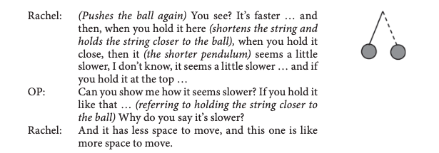
Change or co-existence?
Their explanations are illuminated using coordination class theory: in each context, the students are attuned to specific affordances and read out specific information, and therefore come up with different inferences to the critical determination of ‘fast’ (Parnafes & diSessa, 20013, p. 24)
Parnafes & diSessa, 20013, p. 25
This led to the discovery of an important new relationship (Parnafes & diSessa, 20013, p. 26)
Parnafes & diSessa, 20013, p. 26
Parnafes, O. & diSessa, A. A. (2013). Microgenetic learning analysis: A methodology for studying knowledge in transition. Human Development, 56(1), 5-37.
Parnafes, O. (2007). What does “fast” mean? Understanding the physical world through computational representations. The Journal of the Learning Sciences, 16(3), 415-450.
Notes:
14-18 year old students

Slide 21
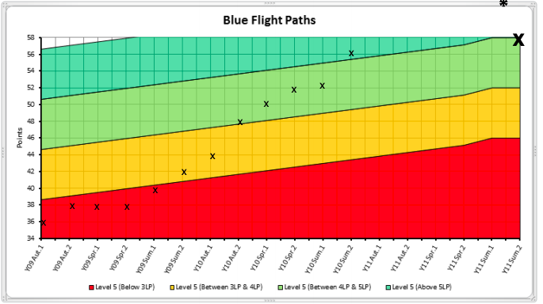
The problematic flight path
• Stigmatises normal patterns of learning
• In a performativity culture, places unfair burdens on teachers
• May lead to unnecessary interventions and inappropriate targets
• Challenge of mastery learning

Slide 22
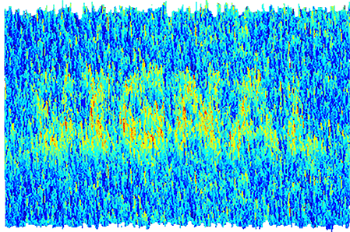
Learning to love ‘the noise’
Learning is a not a linear progression to expertise but involves periods of stasis and even regression. Experts can revert to intuitive ideas (Goldberg & Thompson-Schill, 2009).
Suggestions:
• Expect student learning to progress and regress
• Draw conclusions about progress over extended periods of time and multiple assessments
• Resist simplistic models of change
Goldberg, R. F., & Thompson-Schill, S. L. (2009). Developmental “roots” in mature biological knowledge. Psychological Science, 20(4), 480-487.

Slide 23
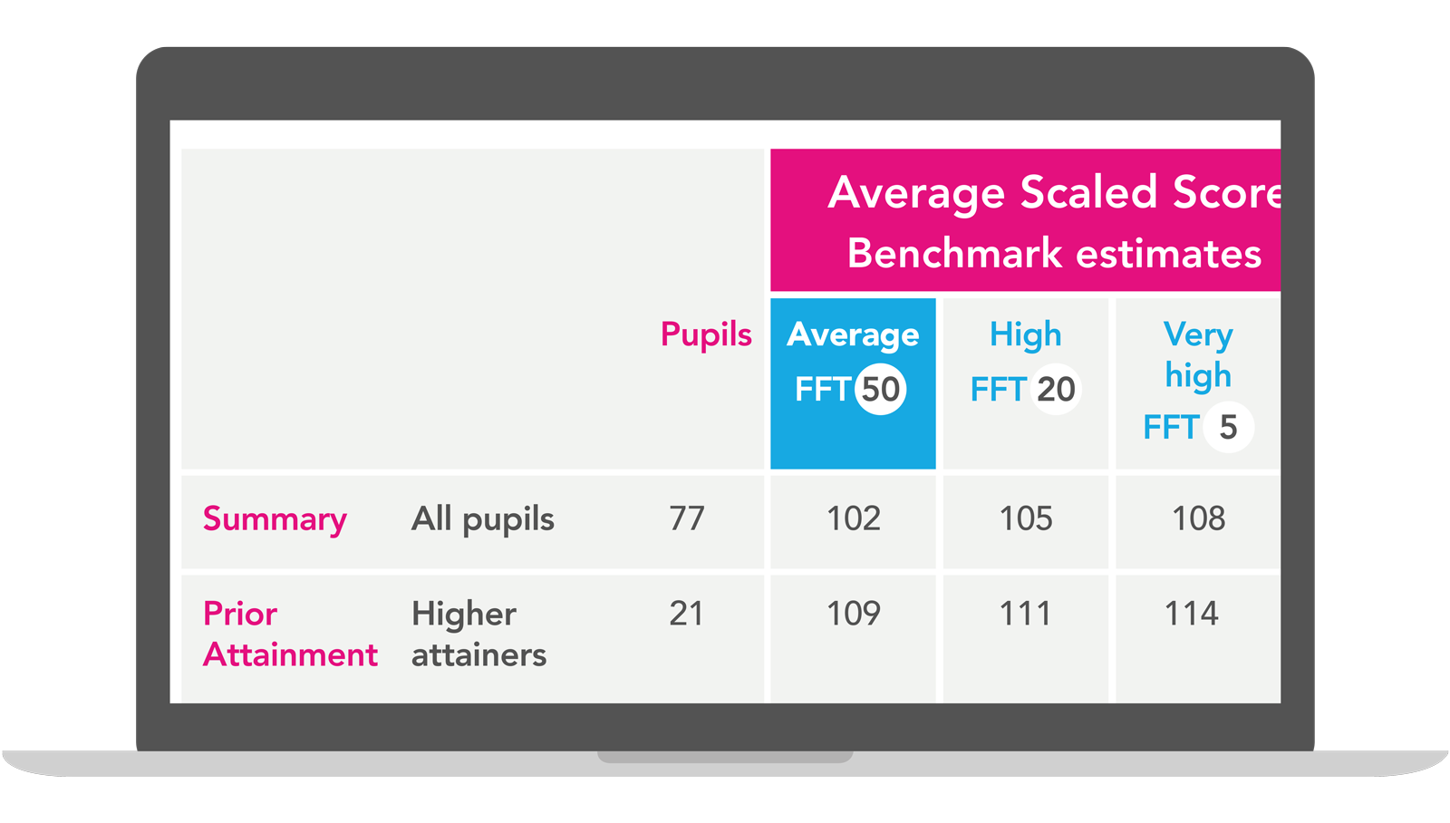
Misunderstanding probabilistic targets
There are three options available:
Average – schools that made the average progress last year (FFT50 – 50th percentile progress)
High – schools that made greater than average progress (FFT20 – 20th percentile progress)
Very High – schools that made much greater than average progress (FFT5 – 5th percentile progress).
Frequently asked questions Fisher Family Trust Website, Available at: https://help.fft.org.uk/articles/faqs/

Slide 24
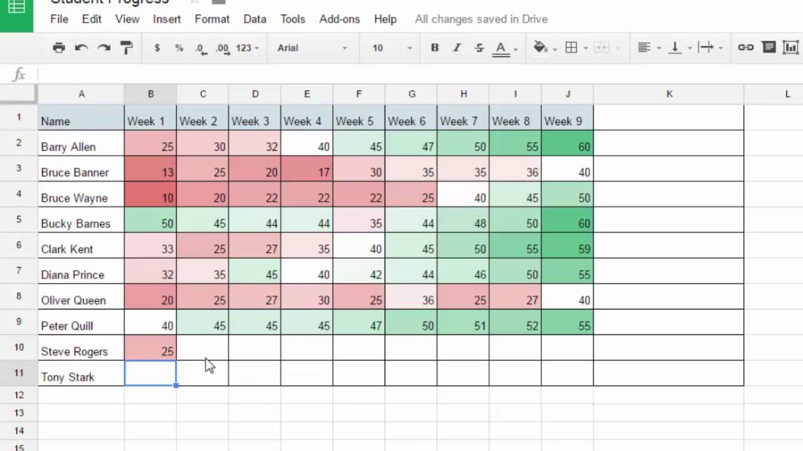
‘Fooled by randomness’ in student achievement?
‘Patternicity: the tendency to ﬁnd meaningful patterns in both meaningful and meaningless data’ (Schermer, 2011, p. 6)
Schermer, M. (2011). The Believing Brain, London, Constable and Robinson.
Taleb, N. N. (2007). Fooled by Randomness. London, Penguin.

Slide 25
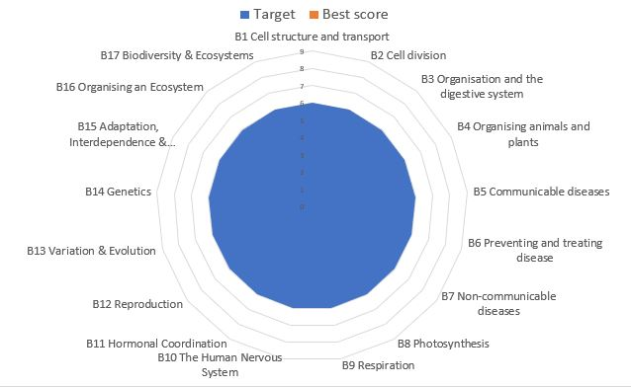
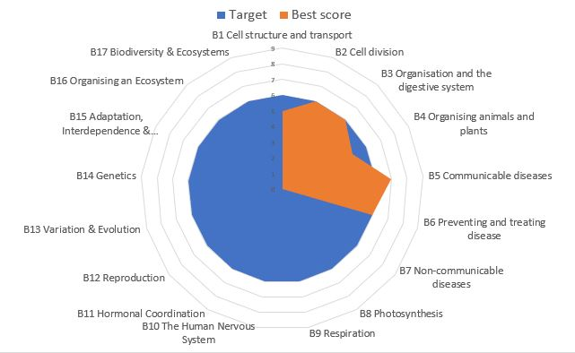
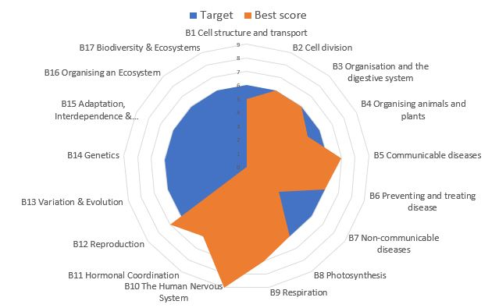
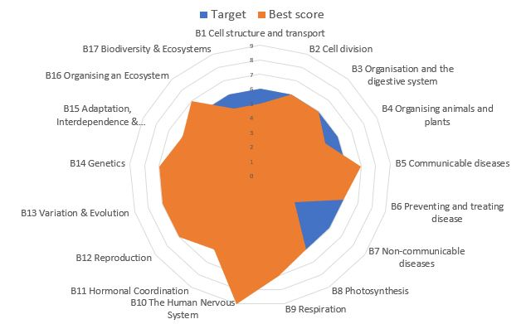
Alternative models of progression
Upstone, P. (2019) Is there an Alternative to the Flight Path Method of Recording Student Progress? Plutonium Science Blog. Available at: https://plutoniumscience.com/2019/07/15/recording-student-progress/ Accessed 21st June 2021

Slide 26
Thank you
© 2020 King’s College London. All rights reserved

